Slide 1

Final Keyword
BCSC1002 Object Oriented Programming
Notes:
‹#›

Slide 2
Keyword final
The final keyword used in context of behavioral restriction on:
Variables
Methods
classes
BCSC1002 Object Oriented Programming
Notes:
‹#›

Slide 3
The role of keyword final on variables
Using final on variable to make them behave as constants.
When a variable is made final- it can be initialized only once either by
Declaration and initialization
final int x = 10;
Using constructor
System allows you to set the value only once; after which it can't be changed.
BCSC1002 Object Oriented Programming
Notes:
‹#›

Slide 4
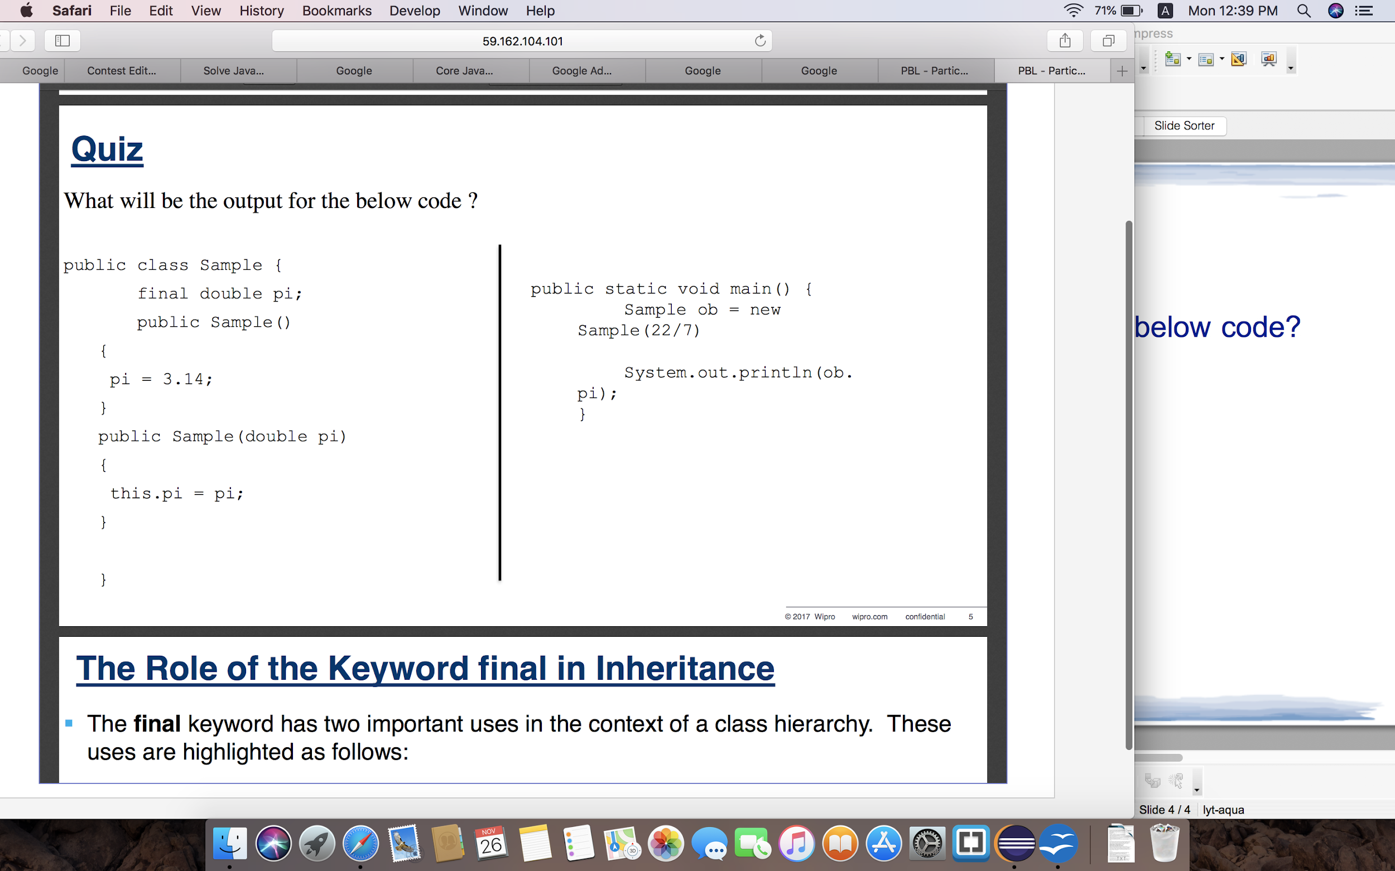
Quiz
What will be the output for the below code?
BCSC1002 Object Oriented Programming
Notes:
‹#›

Slide 5
The role of keyword final in inheritance
The final keyword has two important uses in the context of a class hierarchy. These are as follows:
Using final to prevent Overriding
While method overriding is one of the most powerful feature of object oriented design, there may be times when you will want to prevent certain critical methods in a superclass form being overridden by its subclasses.
Rather, you would want the subclasses to use the methods as they are defined in the superclass
This can be achieved by declaring such critical methods as final
BCSC1002 Object Oriented Programming
Notes:
‹#›

Slide 6
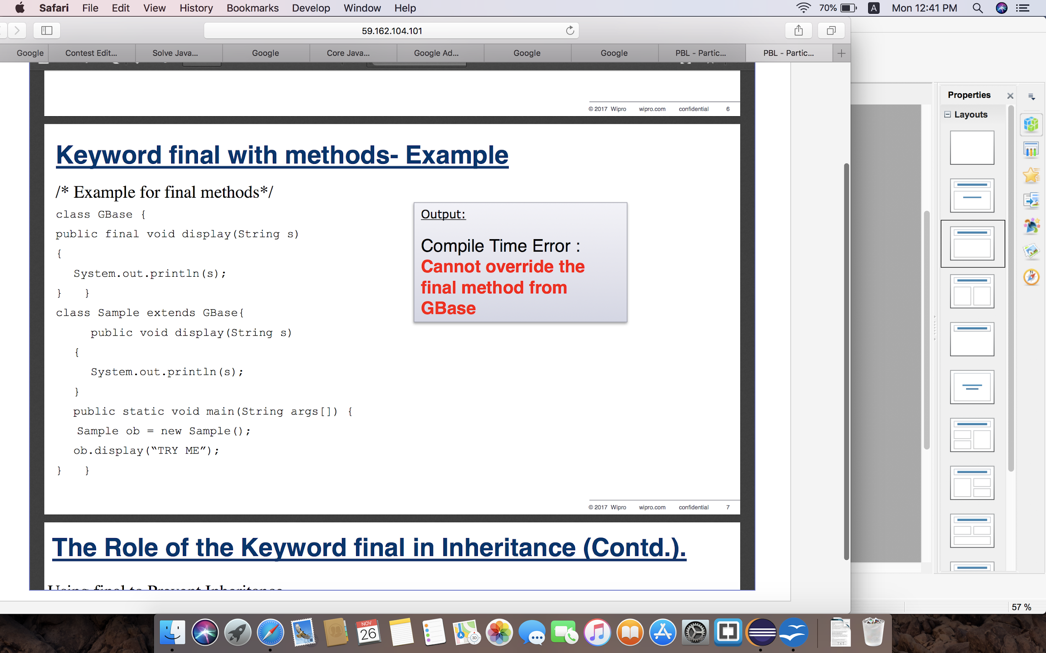
Keyword final with methods- Example
BCSC1002 Object Oriented Programming
Notes:
‹#›

Slide 7
The role of keyword final in inheritance(Contd.)
Using final to prevent Inheritance
Sometimes you will want to prevent a class from being inherited.
This can be achieved by preceding the class declaration with final.
Declaring a class as final implicitly declared all of its methods as final too.
It is illegal to declare a class as both abstract and final since an abstract class is incomplete by itself and relies upon its subclasses to provide concrete and complete implementations.
BCSC1002 Object Oriented Programming
Notes:
‹#›

Slide 8
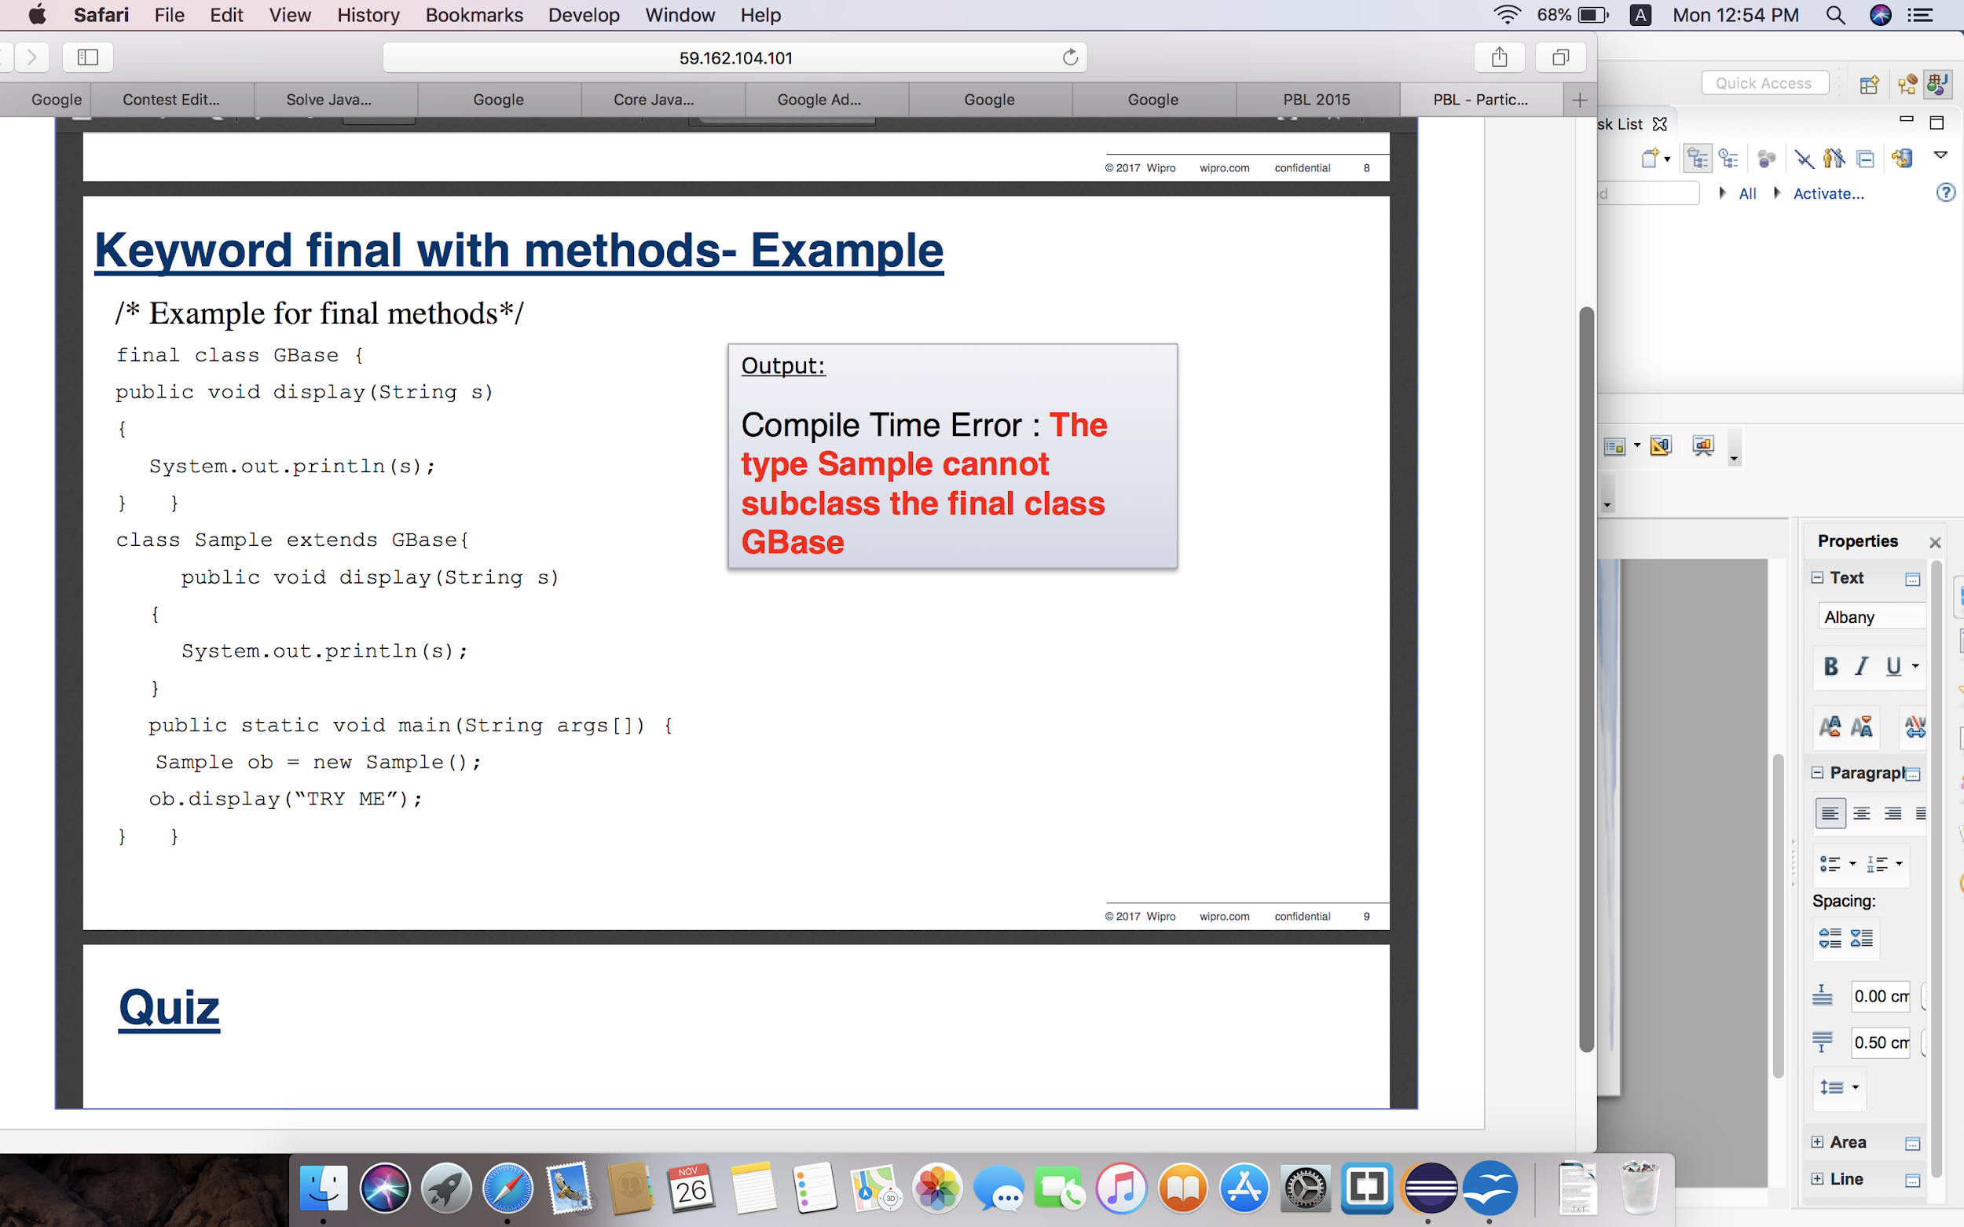
Keyword final with methods- Example
BCSC1002 Object Oriented Programming
Notes:
‹#›

